Slide 1


Frontline Technology:
A New Layered + Connected Approach
For People Fraud Prevention

Slide 2

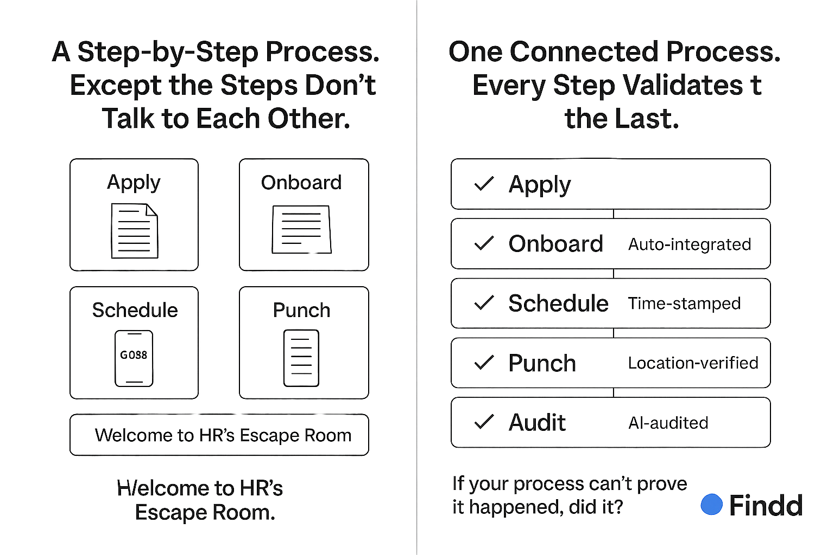
Current State: Decentralized & Disconnected
Apply
Verify
Hiring resources has at least four points of risk…
Applications are traditionally done on paper or online forms
Documents are collected, but rarely reviewed or validated
Oversite on the process is limited
Onboarding and verifications use the same poorly reviewed documents
The employee starts working at the risk of someone different showing up
Day after day the employee punches in and employers hope:
    Risk 1 - The employee is of age to work
    Risk 2 - The documents are real, theirs and valid
    Risk 3 - The applicant and the employee are the same person
    Risk 4 - No one is punching in for them
Onboard
Punch

Slide 3
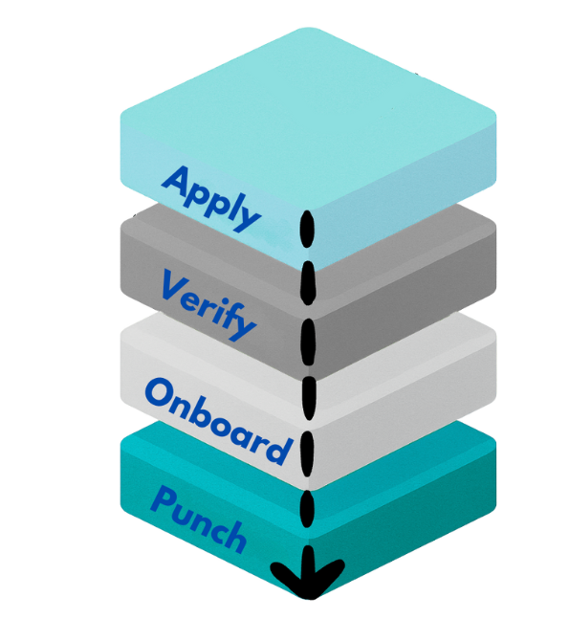
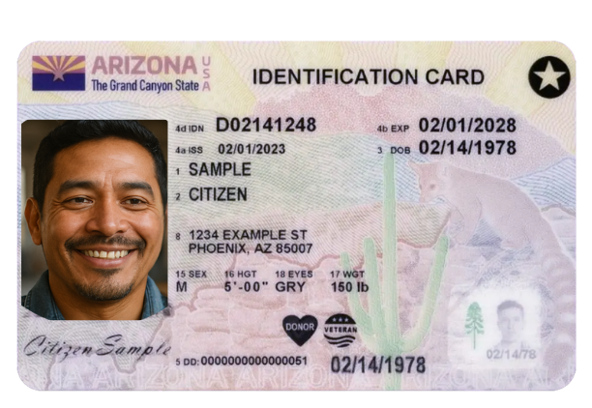
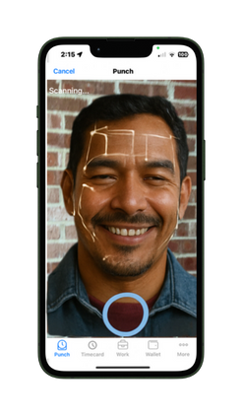


Findd: Connect Your Data & Your Dots
Connecting layers removes risk…
Applicants take a selfie with AI age detection (flagged)
Documents are collected, and pictures are compared to the selfie (flagged)
Oversite is centralized outside of field operations via legal & HR
Onboarding and verifications continues with corporate approval
The employee starts working and biometric facial recognition validates the identity (flagged)
Day after day the employee punches in and the company & client are protected.

Slide 4
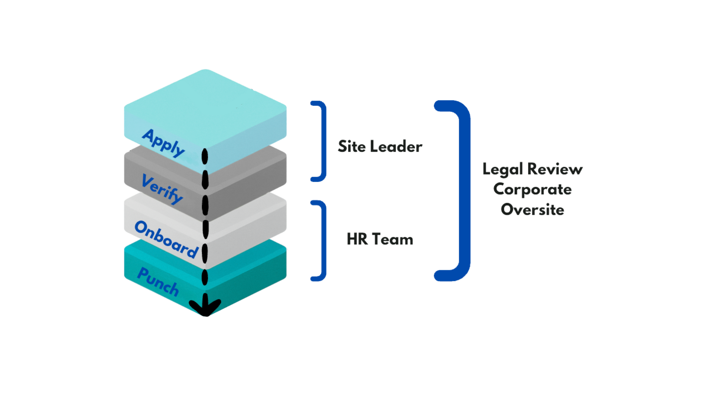
Oversight: Technology To Flag, Teams To Act

Slide 5

Findd: Advanced Frontline Technology
AI Age Detection
Identification comparison
Timeclock Facial Recognition Biometrics
Role based controls and Alerts
Findd.AI is a Software platform that enables customers to have an extra set of eyes in all areas of fraud prevention. The platform uses AI to support age detection preventing underage employment, Document comparison preventing misuse of hiring documents, Facial recognition time collection preventing time fraud and worker swaps while all of these red flags are alerted to a specific leaders to review and disposition. Creating a clear and consistent process of protecting employees and employers

